Slide 1
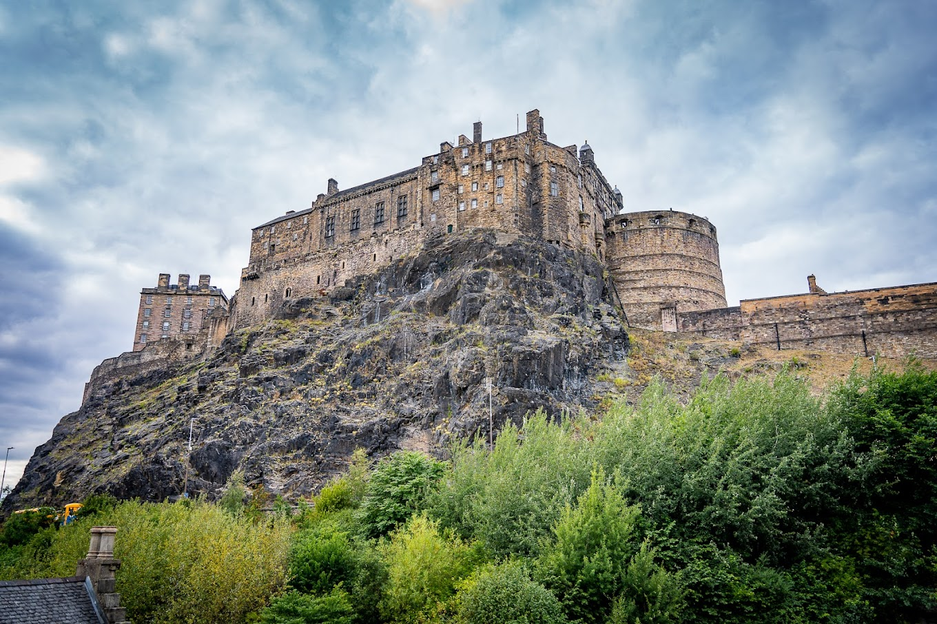



E-Bike Edinburgh
By Ben de Sousa, Alexandros Zachakos, Nolan Willoughby, and Todd House
Notes:
Ben? does slides 1-4. Alex? does 5-6, Nolan? 7-8, Todd? 9-11
This slide: Introduce the members and the project name “E-Bike Edinburgh”
Insert Todd hook element where?

Slide 2
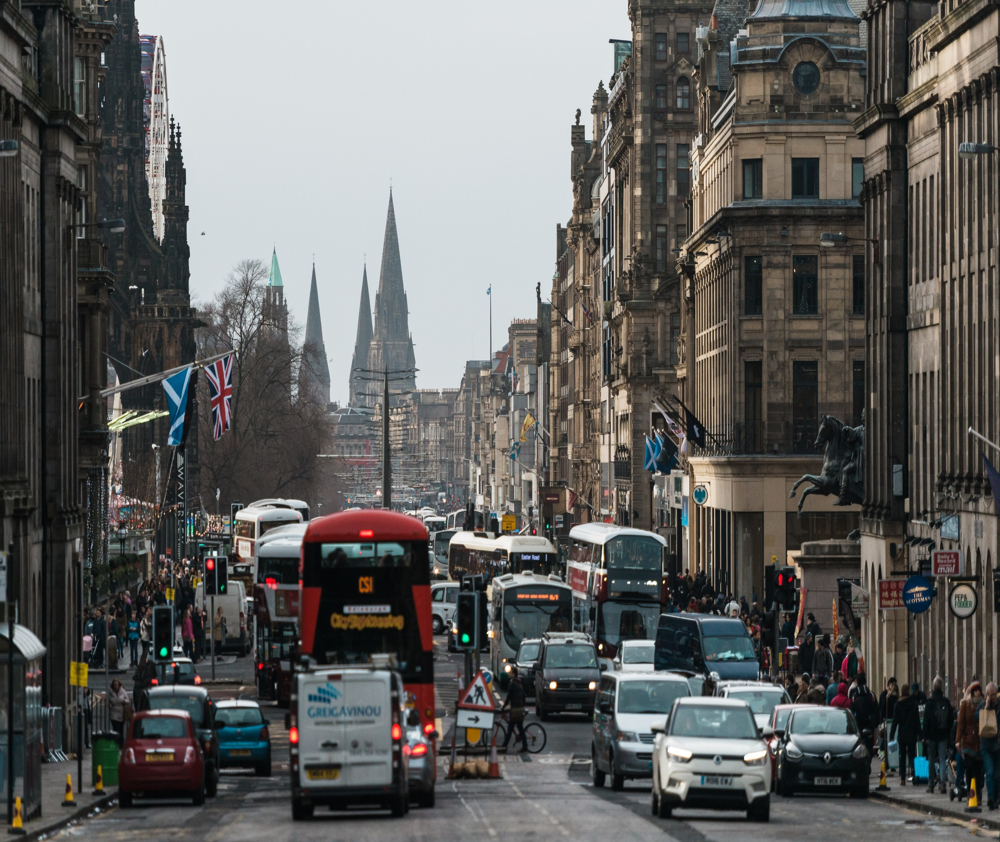

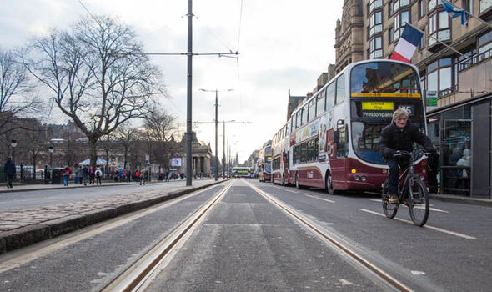
The Problem
High Traffic
Reliance on Fossil Fuels
City Air Quality / Citizen Health
Notes:
The core problem we are trying to solve is crowded streets, excessive reliance on fossil fuels inside the city, this leads to lower air quality, increased noise and light pollution.
We want to take the streets from THIS to THIS (Hit slide to change to second picture)

Slide 3
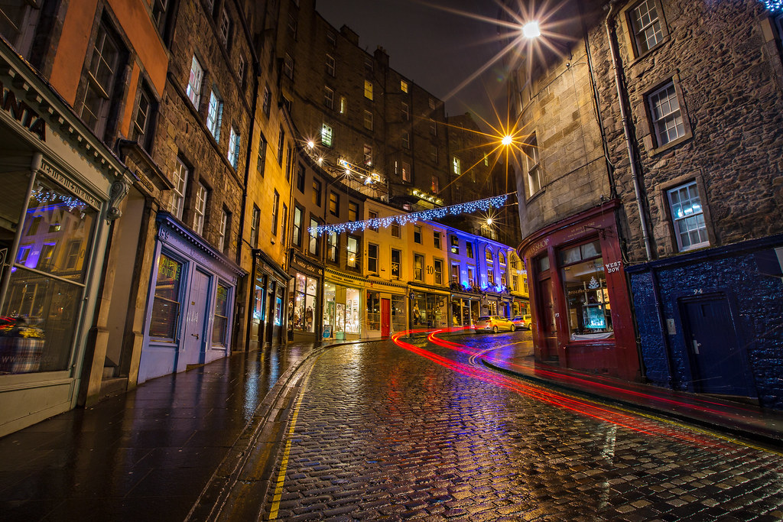

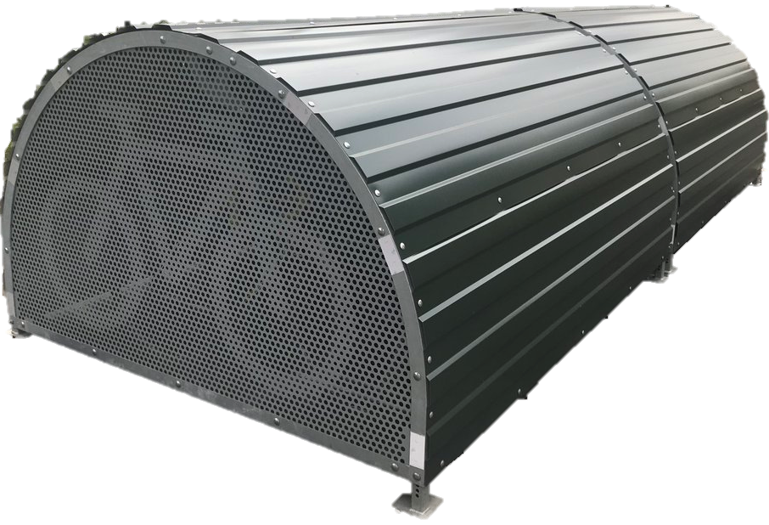
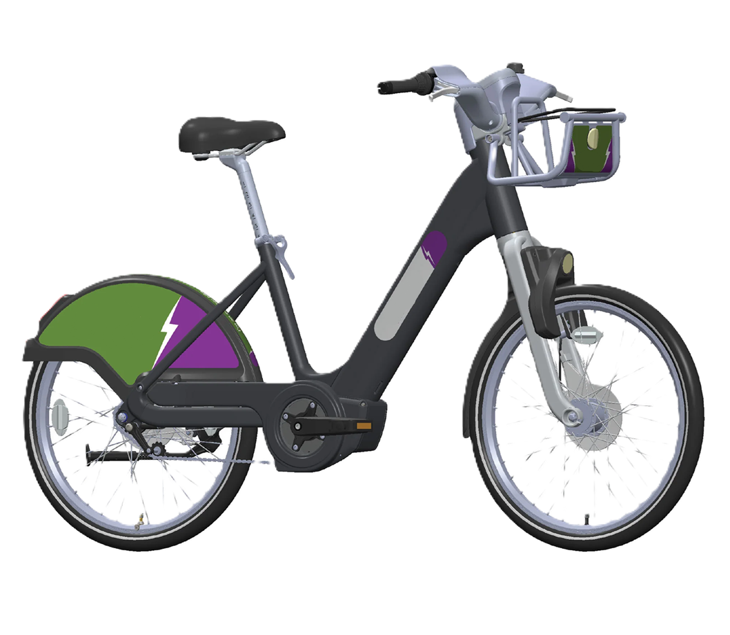
The Solution
E-Bike hire scheme
Less cars - more bikes
Healthy, happy citizens
Notes:
Our solution is an e-bike hire scheme (hit slide).
This will lead us to less cars – more bikes. What do we get? Healthy, happy citizens.
Our scheme would follow a similar system to many other cities around the world and is based off the old Bike scheme
In Edinburgh from 2018 to 2021. This solution will be improving upon some of the potential failure points of the old scheme, namely reducing possible theft and vandalism via bike hangars (hit slide).
Edinburgh will have fewer traffic accidents, CO2 emissions, noise pollution, and light pollution. Importantly, the happiest countries have higher intracity cycling. Denmark #2 in happiness, 90% bike ownership, notably, cycling accounts for 21% of trips under 10 kilometers and 15% of all trips in Denmark, showcasing its versatility as a mode of transport.
The city already has 200 bike hangars located throughout the city and is interested in expanding the count. This is evidence of a successful product that users choose to pay into to increase bike security and reduce weather effects.
https://roadandmountainbikereviews.co.uk/25-striking-cycling-statistics-in-denmark/
https://cyclehoop.com/product/bikehangar/ - £4000 per Six cycle parking spaces in half a car parking space

Slide 4
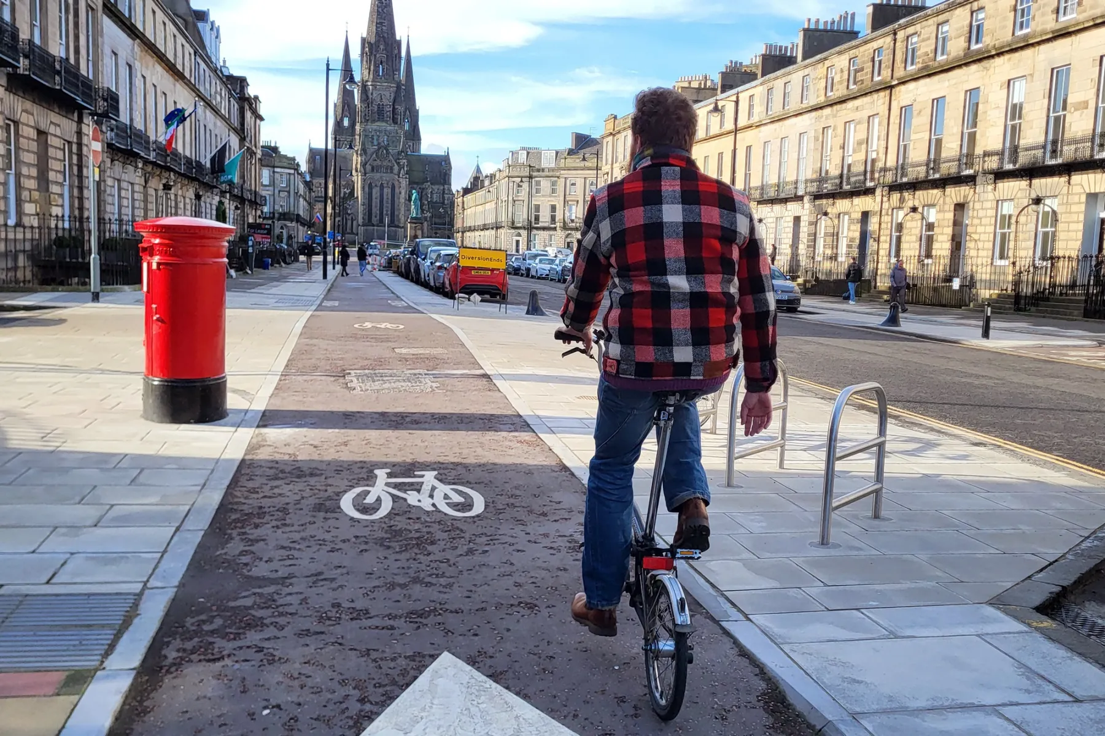



ENVIRONMENT
E
GOVERNANCE
Reduce Traffic
Fuel
Rubbish
SOCIAL
Infrastructure Damage
Council Investment¹
Industry Investment
Employee Benefits
Value Proposition
S
Bike Availability
Distance to Dock
Usage Cost
Dock Availability
POI Coverage
G
Notes:
Now we’ll explain to you our value proposition:
(hit slide) Environmental value is comprised of analysed value of reduced traffic, reduced fuel consumption, reduced rubbish on roads.
(hit slide) Social value is comprised of bike availability, distance to dock, usage cost, dock availability, and POI coverage
(hit slide) Governance value is comprised of reduction in infrastructure damage which leads to a reduction in council investment. The Council Roads and Infrastructure Investment Programme for 2025/26 proposes the capital budget of £25.686m should be allocated across six different work streams.
The carriageway and footways work accounts for £18.161m or 71% of the available funding.
We also quantify industry investment and employee benefits in the governance value score.
https://democracy.edinburgh.gov.uk/documents/s82577/8.1%20-%20Roads%20and%20Infrastructure%20Investment%20-%20Capital%20Delivery%20Priorities%202025_26.pdf
The Roads and Infrastructure Investment Programme for 2025/26 proposes the capital budget of £25.686m should be allocated across six different work streams: carriageways and footways; street lighting and traffic signals; road structures; other asset management; road operations and miscellaneous. The carriageway and footways work accounts for £18.161m or 71% of the available funding

Slide 5
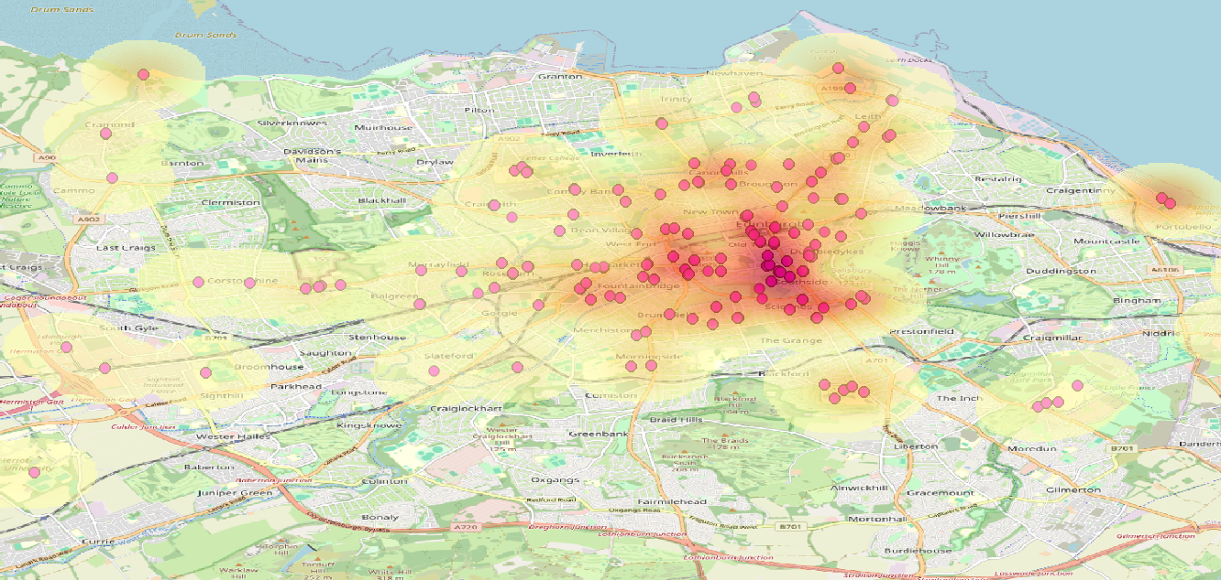
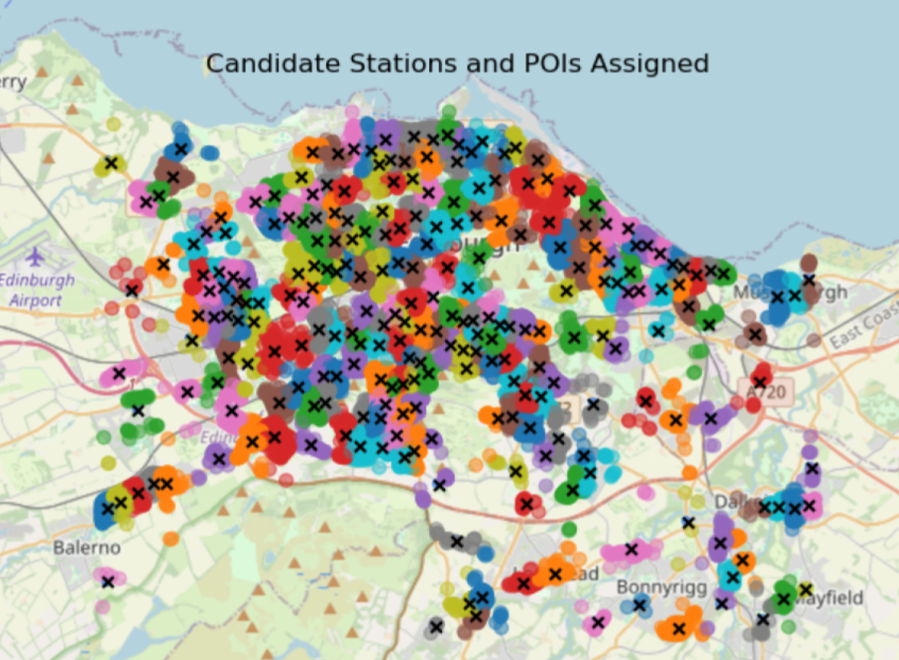

Underlying Magic
Historic Stations
New Candidate Stations
by Cluster
Notes:
So how does this all work? (hit slide)
Here we have a heatmap of the old scheme’s bike station locations and their coverage density.
You can see here (gesture to the densest area) the highest density of bike trips and stations is centered around the old town and the university.
However, we don’t want to rely too much on the old information. The scheme only lasted 3 years after all. (hit slide)
So we went and created 250 clusters to group roughly 33 thousand points of interest to consider as candidates for installing stations.

Slide 6
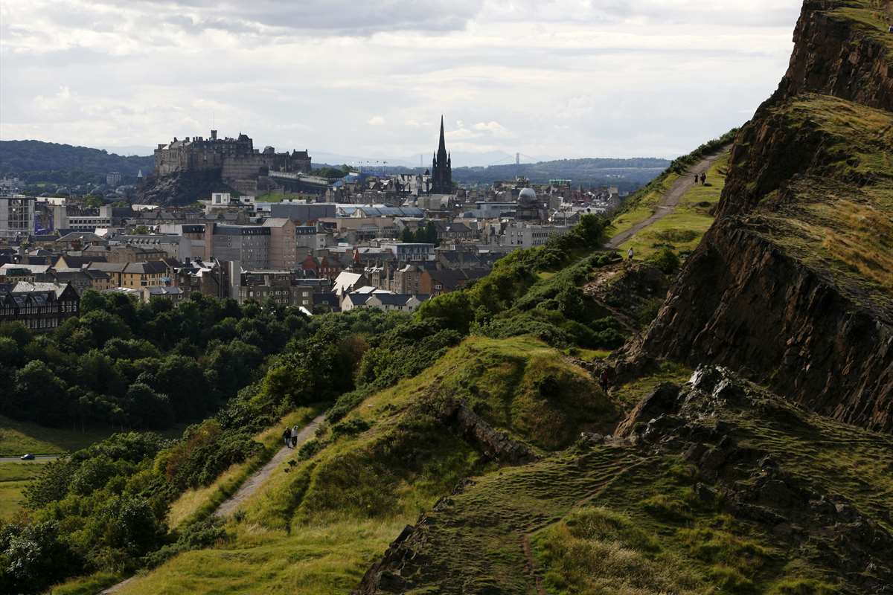
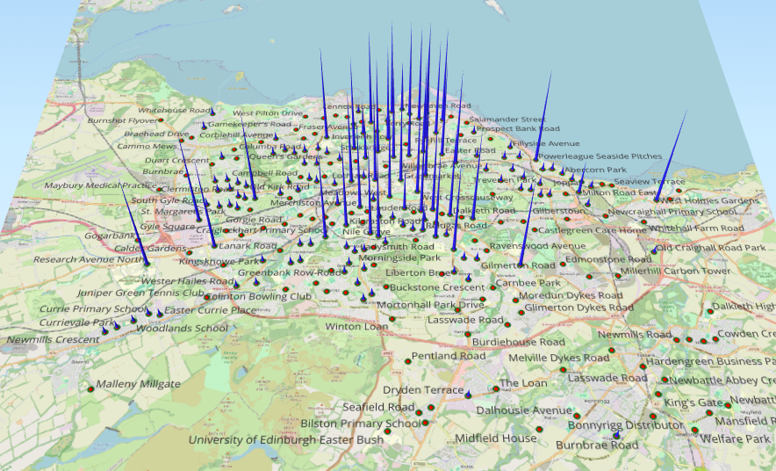
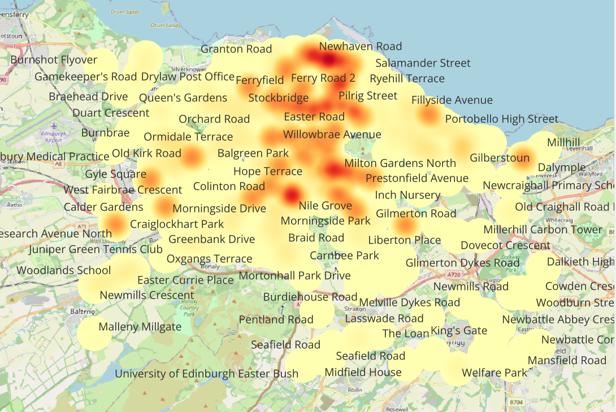
Outputs
 | Stations | Bikes | Hangars
Month 1 | 27 | 1440 | 288
Month 2 | 21 | 865 | 173
Month 3 | 94 | 572 | 116
Total | 142 | 2877 | 577
Notes:
This gives us the following rollout plan over 3 months with a total of 142 stations, 2877 bikes, and 577 hangars. As you can tell by the ratio of bikes to stations by month, the most important and largest stations are opened first and then we start opening smaller stations that provide wider access. This also allows the revenue to begin during month 1 by placing the high demand stations in month 1. What does that look like? Well here is a 3d bike density render.

Slide 7
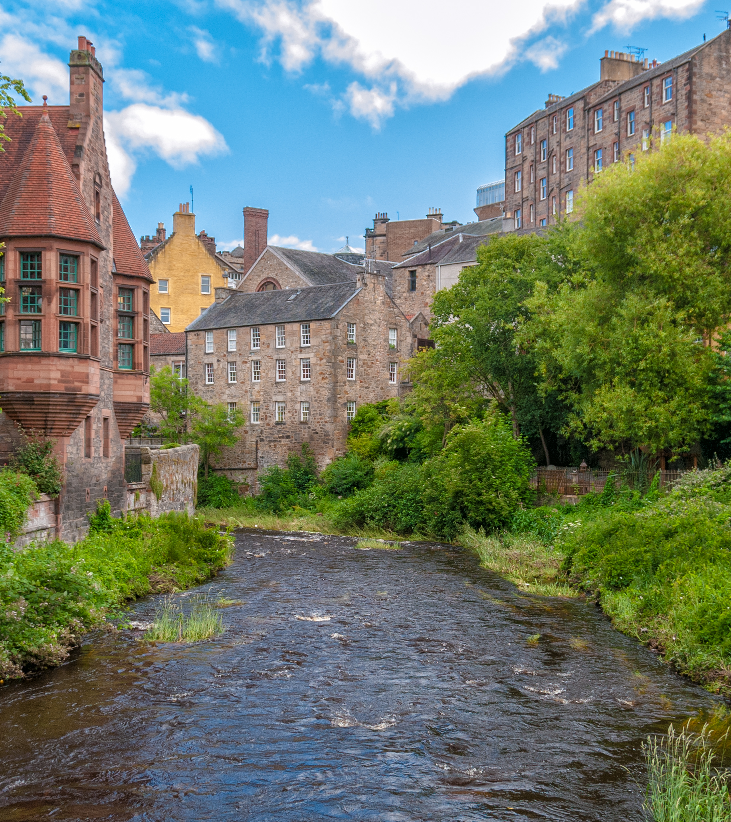
Financial Projections
and Key Metrics
Budget: £3,750,000
Fixed Startup Costs:
£4000/hangar, £500/bike, £40/dock
Cost per user: £1.50 + £0.10/min
Monthly Revenue: £305,607.40
Recoup time: 13 months
Notes:
What will it take to achieve this outcome? This solution requires a budget of £3.75 million. This budget is exclusively fixed startup cost to purchase bikes, and purchase and install hangars and docks. A reasonable approach would be to split this cost between the council, local companies, and possible sponsors. These costs would only be applicable for the first year of operation and subsequent operational expenditures would be X? to account for maintenance, bike replacement, and overhead. The cost to the user would be £1.50 to unlock and £0.10/min use. This results in a time to recoup the initial fixed costs of 13 months.
https://edinburghcyclehire.com/how-it-works
https://www.edinburgh.gov.uk/news/article/14272/trial-cycle-hire-scheme-for-edinburgh-launched
Average trip length: 32.4 min

Slide 8




SWOT
Cover 75% of POIs
Hangar Docking
Flexible Modelling
Branding Partnerships
Bike Lane Analysis
Maintenance Activities
STRENGTHS
OPPORTUNITIES
S
W
O
T
WEAKNESSES
THREATS
Relies on Assumptions
Data basis
Cost
Lothian Buses
VOI Bike Scheme
Vandalism
Notes:
We’ve conducted a SWOT analysis to help provide a holistic view of the scheme in the existing environment. SWOT stands for Strengths, Weaknesses, Opportunities, and Threats. Strengths: our POI coverage, hangar docking, modular modelling – flexible and easily adjustable. Weaknesses – as with any design, relies on assumptions – did we make the right ones?, the data basis relies part on the former failed scheme, which we tried to mitigate over reliance on while still taking valuable information from. The POIs used to dictate coverage could not be ideally representative, and the startup cost. Opportunities: Branding partnerships, remember the bike and hangar from the earlier slide? Analysis of bike lane structure and prevalence on user likelihood, and in depth maintenance activities. Threats: Lothian Buses already provide a good service that has reliable and good coverage in the city, VOI is running a trial of their own electric bike scheme currently, and vandalism – of which we plan to mitigate.

Slide 9
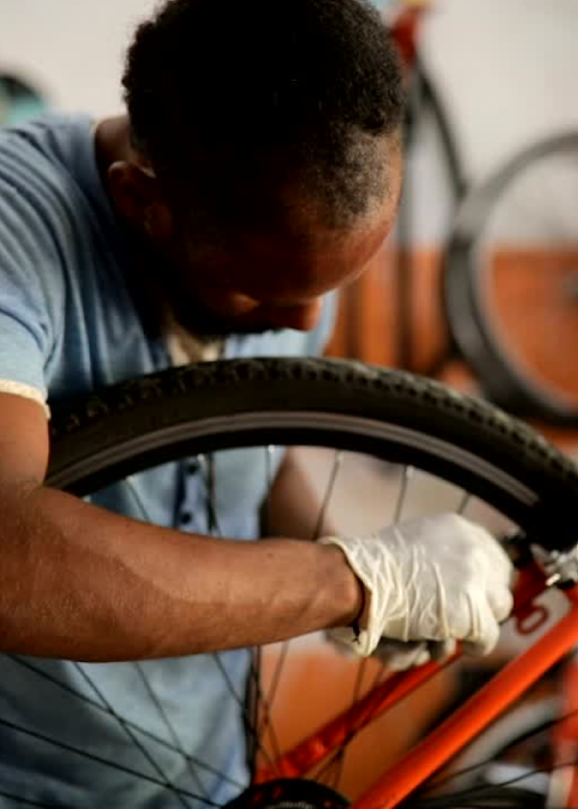
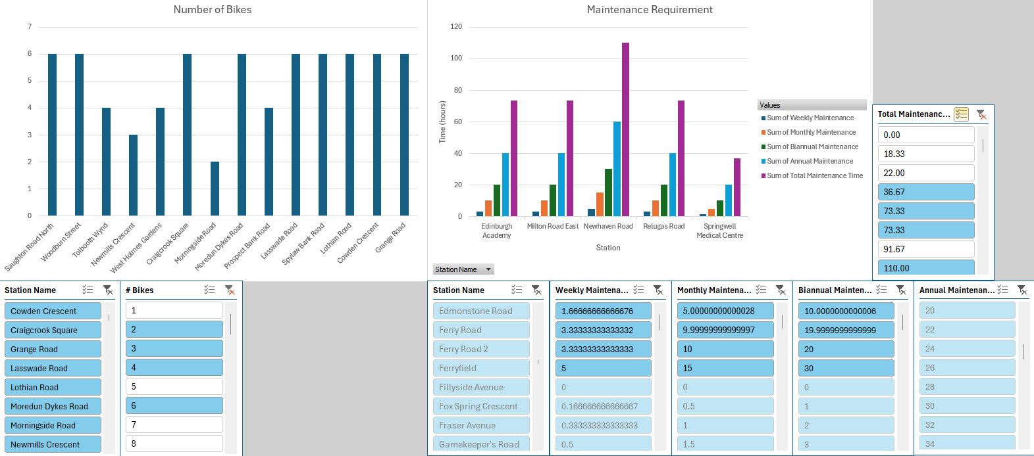
Maintain,
Sustain,
Gain
Success
Demand
User
Satisfaction
Availability
& Quality
Maintenance
Notes:
This system is proven in many other cities. It isn’t a question of if it can work. It is a logistic question of how you maintain
It and keep it working at an acceptable level to users. So we propose maintenance is a base that drives everything, what does maintenance do? (hit slide) it increases availability and quality of the product. What does this do? (hit slide) it increases user satisfaction. What happens with increased user satisfaction? (hit slide) you get higher demand, network effect, etc. What happens with increased demand? (hit slide) more maintenance. But most of all? (hit slide) success.
We have also developed a dynamic analytic tool to check the number of bikes at any station, expected maintenance for each station by category, and is the basis of a forecasting and scheduling tool for planning long term maintenance routines to shadow seasonal demand changes.
https://dojobusiness.com/blogs/news/bicycle-shop-break-even-repairs?
Planning/forecasting tool/dashboard
Community incentives

Slide 10
Current Status,
Accomplishments, and
Timeline
Maintenance Planner and GIS tool
3-month long rollout method
Recoup initial investments in 13 months
Save upwards of £4 million council expense annually
Notes:
Lets summarize what we’ve talked about so far. What have we done? Where are we at? And what does the road ahead look like?
We’ve built a highly flexible modelling structure; we’ve built a dynamic maintenance planning tool and applied a dynamic GIS tool for visualization, planned a 3-month rollout to smooth out capital requirements, recoup initial fixed costs in 13 months, and have the potential to save the council up to £4 million in road infrastructure expenditures – that money could be simply savings or reinvested into better bike lane infrastructure.

Slide 11
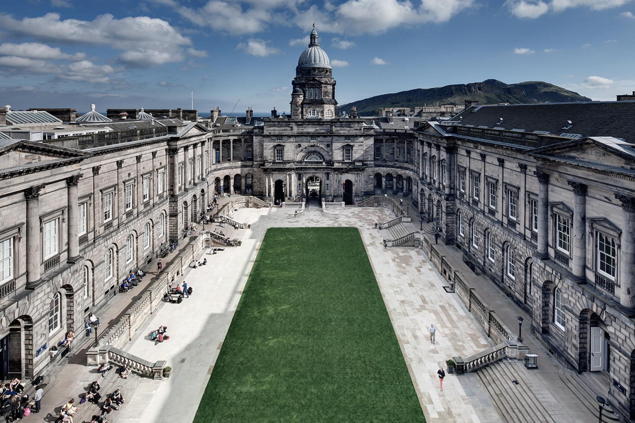
Questions?

